Slide 1
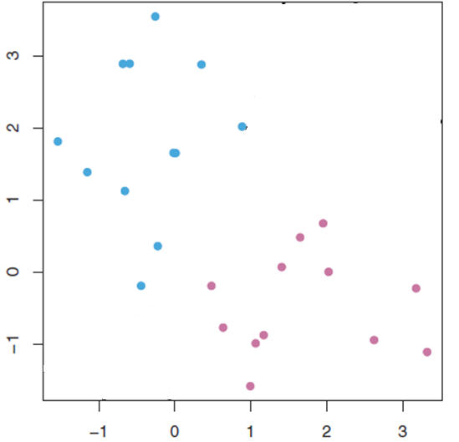
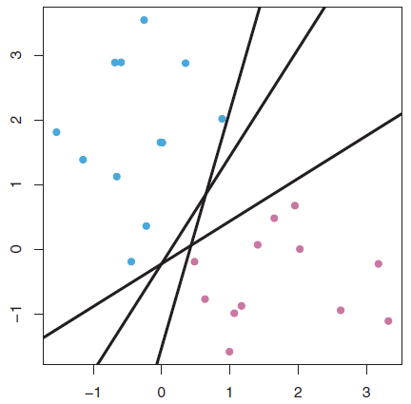
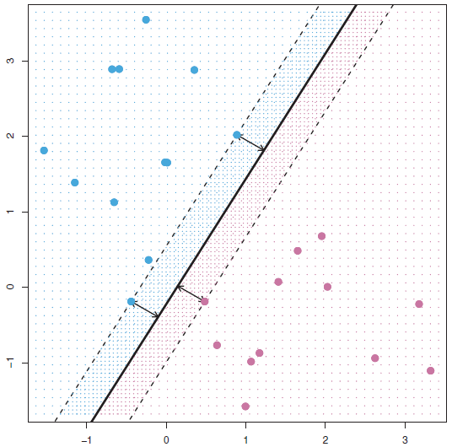
2.3. Machine Learning: SVM
SVM: Linear Case.
Margin
Notes:
https://www.quora.com/What-are-Kernels-in-Machine-Learning-and-SVM

Slide 2
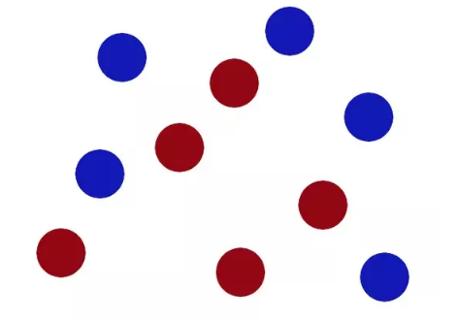
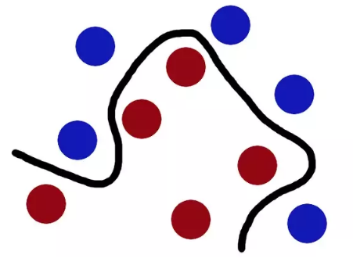
2.3. Machine Learning: SVM
SVM: Nonlinear Case.

Slide 3
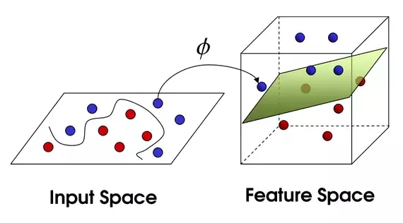
2.3. Machine Learning: Kernel Method
SVM: Kernel Method.
Notes:
Light and heavy balls.

Slide 4
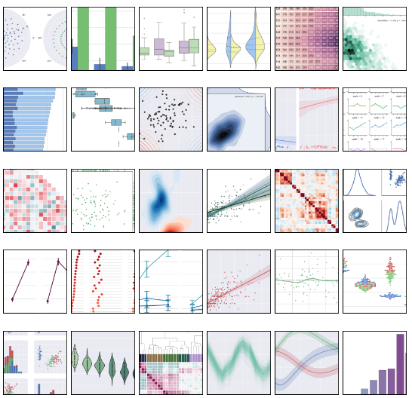
2.4. Visualization
Packages:
1) Python Packages:
matplotlib, seaborn, …
2) R Packages:
ggplot2, shiny, …
Basic elements:
line, curve, marker,
patch, bar, box,
arrow, contour,
histogram, axis,
colormap, colorbar,
figure, image,
…

Slide 5
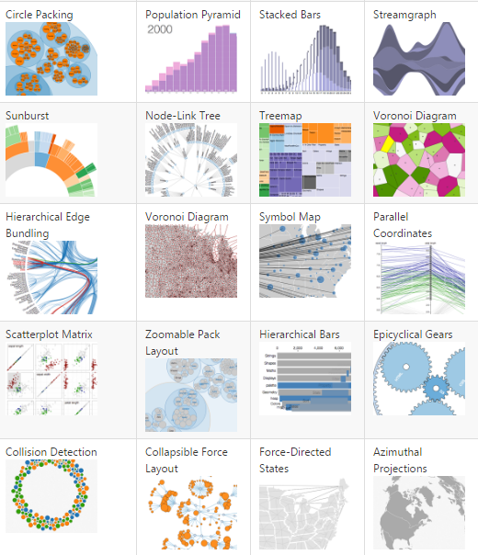
2.4. Visualization
D3.js is a JavaScript library for manipulating documents based on data. D3 helps you bring data to life using HTML, SVG, and CSS.
D3 creates dynamic visualizations.

Slide 6
3. Next Steps
1) Online Learning:
Coursera - Data Science Specialization:
https://www.coursera.org/specializations/jhu-data-science
Udacity – Intro to Data Science:
https://www.udacity.com/course/intro-to-data-science--ud359
Dataquest – Becoming a Data Scientist:
https://www.dataquest.io/path/data-scientist
2) Datasets:
Kaggle: https://www.kaggle.com/
KDnuggets: http://www.kdnuggets.com/datasets/index.html
UC Irvine Machine Learning Repository http://archive.ics.uci.edu/ml/
3) News, Blogs:
KDnuggets: http://www.kdnuggets.com/datasets/index.html
Flowing Data: http://flowingdata.com/
Data Science 101: http://101.datascience.community/

